Slide 1
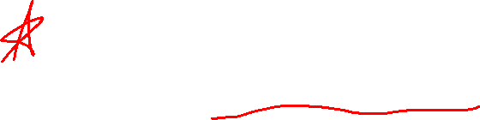
Chapter 8 Further Applications of Integration
Introduction

Slide 2
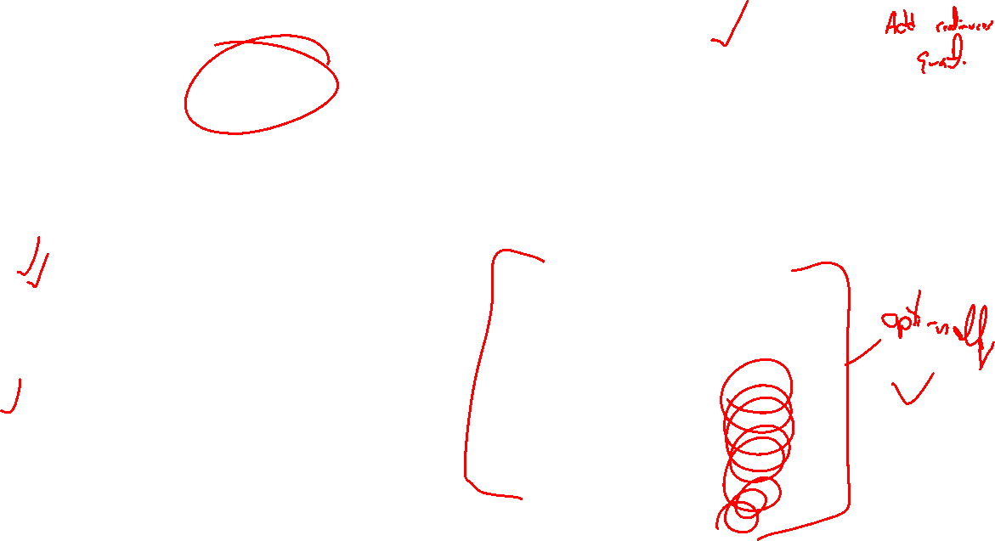
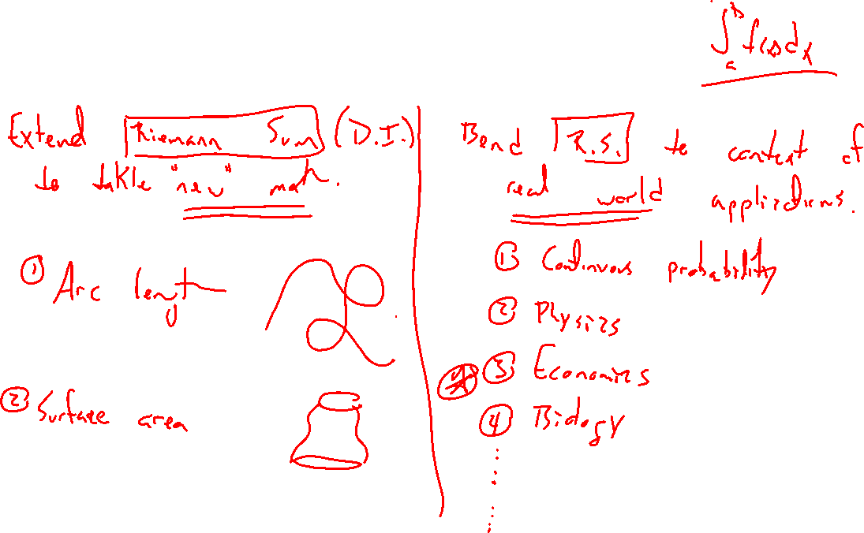
More than Area Under the Curve
Notes:
Bend Riemann sum idea to beyond areas
- arc length, surface areas (similar to volumes of revolution)
- Applications: physics, biology, probability (not covered, read if interested)
Already did volumes of revolution. (Section 6.2)
1. Archimedes and the volume of the sphere. http://math.gmu.edu/~rsachs/math400/History%20Method%20of%20Archimedes%20Gould.pdf
2. Cavaleri and volume of sphere http://www.matematicasvisuales.com/english/html/history/cavalieri/cavalierisphere. html
Physics and engineering (pressure, force, center of mass): Sum of pressure, low dim moments) https: //en.wikipedia.org/wiki/Work_(physics)
Economics (surplus): Sum of demand https://en.wikipedia.org/wiki/Economic_surplus
Biology (Blood flow): Sum cylinder (circle) https://en.wikipedia.org/wiki/Cardiac_output
Probability: Sum of individual probabilities Key for each is to compute via summation of continuous values

